Slide 1
SRD Science Meeting – Agenda 9/12/19
Overview and highlights from Int’l Conf. on Ultrafast Structural Dynamics (ICUSD) Tim van Driel
Overview and highlights from Int’l Conf. on Inelastic X-ray Scattering (IXS2019) Hasan Yavas (Georgi Dakovski)
Overview and update on MEC petawatt project Gilliss Dyer
Run-18 in-house beamtime proposals – process and discussion
Recent and upcoming events: Users’ Meeting, LCLS SAC, LCLS S&I Review, LCLS-II workshops etc.

Slide 2
LCLS In-House Research and Development Beamtime Policy
Guidelines
Up to 25% of beamtime per run, allocated by LCLS Director, with a nominal distribution of ~15% driven by commissioning and technical development needs, and ~10% driven by scientific career development opportunities and needs for LCLS scientists.
In-house beamtime will be evaluated across the portfolio, and balanced to advance the strategic interests of XFEL science and the LCLS facility.
An important objective of in-house beamtime is developing LCLS staff scientists and expertise to remain at the forefront of their fields.
Activities must not undermine proposals submitted to the PRP by the LCLS user community, nor can they make use of privileged information from PRP submissions, or other confidential sources
Additional Guidelines for Run 18:
Limited technical resources available (minimize resource demands for in-house, make a clear case…..)
Priority for activities that are relevant for LCLS-II, or other clear need for time in Run 18
Demands on staff time and priority for LCLS-II preparation work (e.g. L2S-I instrument development)
Limited in-house for TMO, and possibly none for ChemRIXS (following instrument commissioning and early science)
Proposals Due:
8 am Mon. 10/14

Slide 3
LCLS In-House Research and Development Beamtime Policy
Proposal Criteria:
Proposals should advance the strategic interest of LCLS via one or more of the following:
Developing LCLS staff scientists and expertise to remain at the forefront of their fields. (This is the primary justification for preserving 10% allocation for scientific career development)
Developing or demonstrating new experimental methods, technical capabilities, or instrumentation with clear potential to enhance the science impact, and exploit the unique capabilities, of LCLS. (Links to LCLS programs, initiatives, or development efforts, e.g. R&D, L2S-I, XIP, AIP, OIP etc. should be clearly articulated, where appropriate.)
Demonstration experiments to attract a new user community and/or establish a new area of science where LCLS will have a significant impact.
Enhancing the operational effectiveness of LCLS.
Activities should not take the form of a measurement using a previously demonstrated technique, or other straightforward use of LCLS. Such proposals should be submitted via the PRP process.
It is noted that there is some overlap in the missions of the In-House program and the M&I PRP. It is up to the proposing scientist to decide the most suitable avenue for a given proposal. Duplicate submissions are typically discouraged but will be allowed for M&I.
Activities must be driven by LCLS scientists. Collaboration is strongly encouraged, but it is important that the contributions and roles of collaborators are well-defined and justified, with a clear leadership position taken by the lead LCLS scientist.
A follow-up summary of results and impact from in-house beamtime is required (internal), and peer-reviewed publication is expected (as appropriate). Prior productivity/impact will be considered in allocation of future in-house beamtime.
Proposals Due:
8 am Mon. 10/14

Slide 4
In House Proposal Scoring
Criteria #1: Appropriateness of the proposal for in-house time
Appropriate for in-house (outside PRP scope), could potentially compete through PRP, not appropriate for in-house
Criteria #2: Commissioning
Commissioning and technical development of new instrumentation. Links to LCLS strategic development plan or development efforts (e.g. R&D, L2S-I, XIP, AIP, OIP etc.) are clearly articulated, where appropriate.
Criteria #3: Career Development
Proposal presents a clear and compelling case for the career development of LCLS scientist(s), and is essential for them to remain at the forefront of their field.
Criteria #4: New Experimental Methods
Proposal will develop or demonstrate new experimental methods, technical capabilities, or instrumentation with clear potential to enhance the science impact, and exploit the unique capabilities of LCLS. Links to the LCLS strategic development plan or development efforts (e.g. R&D, L2S-I, XIP, AIP, OIP etc.) are clearly articulated, where appropriate.
Criteria #5: Demonstration Experiments, New User Community
Proposed experiments will attract a new user community and/or establish a new area of science where LCLS will have a significant impact.
Criteria #6: Operations
Proposal will significantly enhance the operational effectiveness of LCLS (e.g. efficiency or effectiveness in executing experiments and/or analyzing results)
Proposals Due: 8 am Mon. 10/14
All proposals to be evaluated across all criteria
Strongest proposals should have good scores in more than one category
At least 10% of in-house allocations will be justified predominantly by career-development needs
Basic needs for facility ops, e.g. commissioning needs, will not displace career-development below 10% level

Slide 5
In-House Beamtime Review Committee:
• LCLS Deputy for Science* [Chair]
• SRD Director*
• HXR Department Head
• SXR Department Head
• MEC Department Head
• Detector Department Head
*excluded from submitting proposals as scientific lead
Committee recommendations are made to the LCLS Director for allocation of LCLS beamtime
• SED Department Head
• Laser Division Leader
• R&D Program Leads
• PCDS Division Leader, or representative
• AD representative for MD time
• 3 LCLS scientists (rotating – selected from HXR, SXR, MEC)

Slide 6
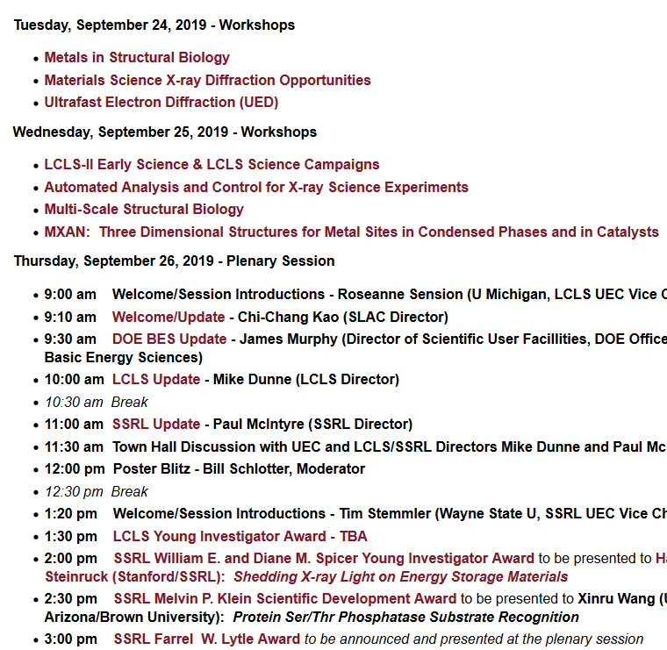
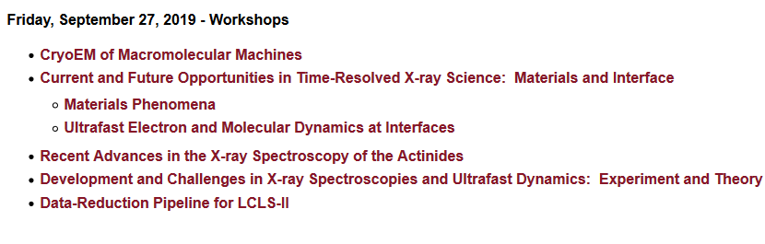
2019 SSRL/LCLS Users’ Meeting

Slide 7
LCLS SAC Meeting: Oct. 17-18
Partial list of topics:
Discussion of Scientific Campaigns
Overview and initial assessment of current proposals
Future target areas for science campaigns
LCLS-II Early Science Plans
TMO (Peter Walter)
ChemRIXS (Georgi Dakovski)
Science & Instrumentation Reviews
Report on Sept. 5-6 review: Materials Science & Condensed Matter Physics with Hard X-ray Methods
Plans for upcoming reviews
LCLS Detector Development Strategy
…..

Slide 8
LCLS Science & Instrumentation Reviews
structure/motivation
Ongoing periodic assessment activity
Periodic reviews covering each area every ~3 years in steady-state
Ensure robust ongoing scientific strategy and planning to keep LCLS world leading
Direct link to LCLS SAC, with SAC member of review panel responsible to present a summary of the review at the subsequent SAC meeting
Audience and output:
Written panel report to LCLS Director, for internal benefit of LCLS facility
Summary presentation and discussion with LCLS SAC (SAC review/approval of panel report)
Review document (developed by LCLS in preparation for the review) is a tool for internal strategic planning
Arranged by combination of instrument (experimental methods) and/or science area
Organization by LCLS scientific staff
Topics may evolve over time to address specific needs or issues

Slide 9
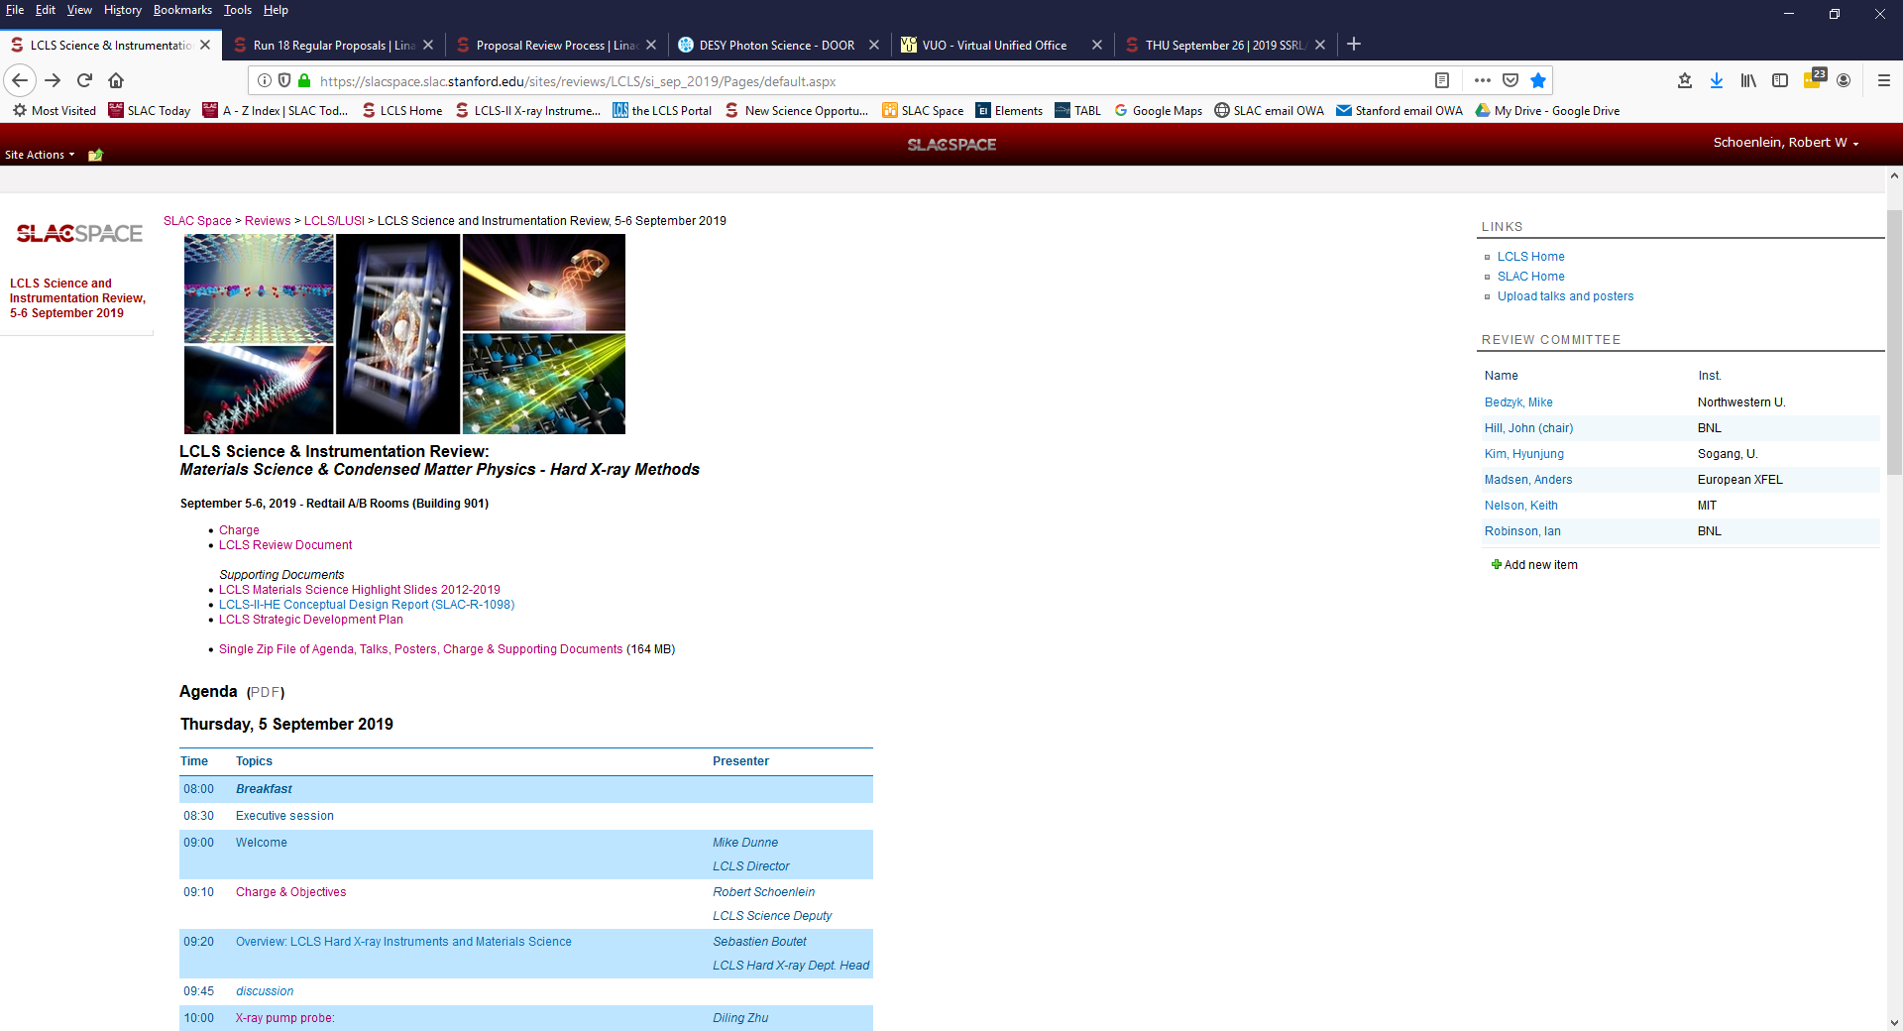
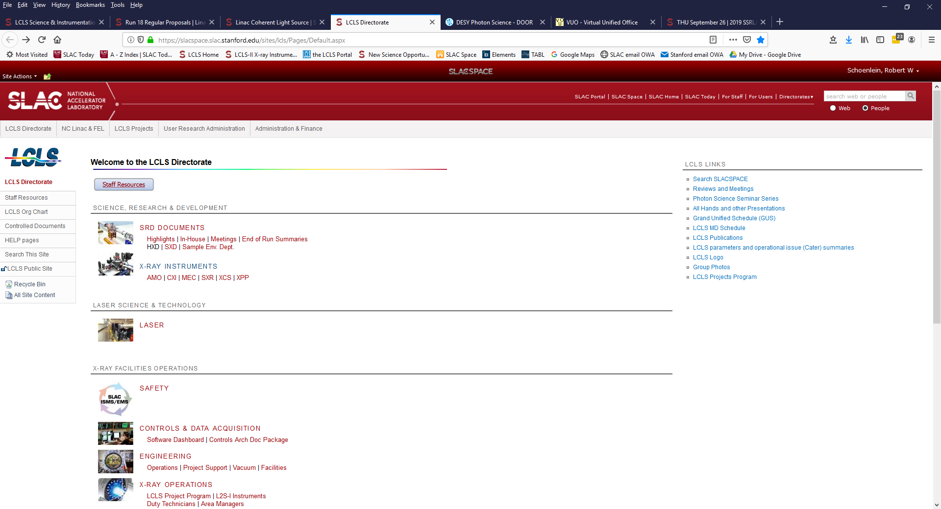

Slide 10
Diagonalization – Roughly by Science Areas
AMO Physics, Strong-field physics, Gas-phase chemistry, clusters, Attosecond-science
TMO, CXI
Condensed-phase chemistry, bio-chemistry, surface/interface chemistry and catalysis
ChemRIXS (NEH 2.2), XPP, XCS
Condensed matter & materials science, soft matter, stochastic phenomena with hard X-rays
XPP, XCS, qRIXS/XPCS (NEH 2.2), TXI (NEH 1.2)
Structural biology and dynamics
MFX, CXI, TXI (coherent imaging)
High energy-density physics, shock physics, plasma physics, materials in extreme environments, nonlinear X-ray science
MEC, TXI, TMO, CXI
Primary role in review
Secondary roles
Also include Detectors, Lasers, Sample Delivery, PCDS etc. at appropriate levels (TBD).
Steady-state: Two reviews per year, covering each area every three years
LCLS-II: Inform early science and L2S-I planning and restructure review areas

Slide 11
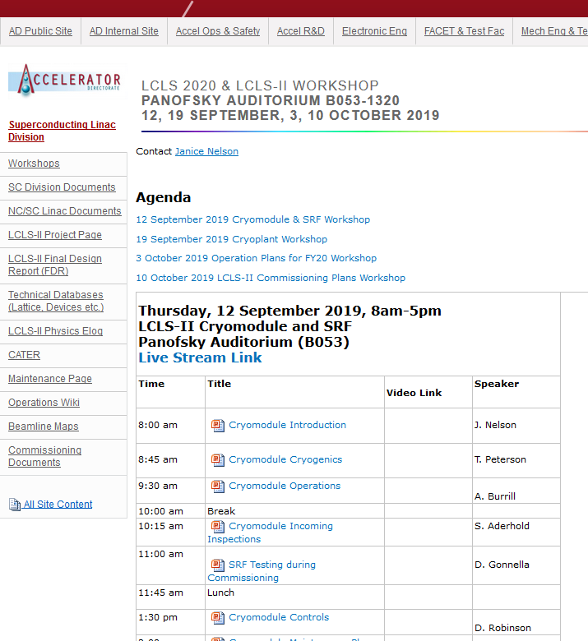
LCLS-II Project Workshops
Sept. 12: LCLS-II Cryomodule and SRF Workshop (Panofsky)
Sept. 19: LCLS-II Cryoplant and Cryogenic Systems (Panofsky)
Oct. 3: Operation Plans for FY20 (Panofsky)
Oct. 10: LCLS-II Commissioning Plan (Kavli)

